Slide 2
Objectives
^{Explain the evolution of HTML}
Explain the page structure used by HTML
List the drawbacks in HTML 4 XHTML
List the new features of HTML 5
^{Explain CSS}
^{Explain JavaScript}
^{Explain jQuery}
Explain browser support for HTML 5
Notes:
Evolution: qua trinh phat trien

Slide 3
Introduction
Hypertext Markup Language was introduced in 1990.
HTML 5 was recommended as a standard by W3C in 1997.
Majority of the browsers support HTML 5 element and Application Programming Interface (API).
Notes:
Recommend “ gioi thieu
Consortium /kənˈsɔːrtiəm/ : hiep hoi
World Wide Web Consortium, viết tắt W3C, là một hiep hoi – to chuc lập ra các chuẩn cho Internet, nhất là cho World Wide Web.
Chủ tịch của W3C là Ngài Tim Berners-Lee, người sáng tạo ra HTTP (HyperText Transfer Protocol) và HTML(HyperText Markup Language).
Internet dựa trên các kỹ thuật đó.
Mỗi tiêu chuẩn đi qua bốn giai đoạn: Phác thảo (Working Draft), Chỉnh sửa Cuối cùng (Last Call), Trình chuẩn (Proposed Recommendation) và Chuẩn đủ Tư cách Ứng cử (Candidate Recommendation), trước khi được gọi là Chuẩn Chính thức (Recommendation).
Tiêu chuẩn thiết kế web cho các người xem theo các trình duyệt web
Website khi thiết kế, neu tuân thủ tiêu chuẩn của w3c => mang lại sự ổn định: website xem bang trình duyệt gì cung duoc (IE, Firefox, Chrome, Opera ,..)
Thiết kế website chuẩn SEO (tối ưu máy tìm kiếm – quảng cáo google)
Các máy tìm kiếm đọc web tuân theo cấu trúc w3c, vì thế khi thiết kế website việc tuân thủ w3c là yếu tố đầu tiên nhằm tối ưu hóa bộ máy tìm kiếm. Tạo hiệu quả cao cho việc quảng bá mà cụ thể là quảng cáo google

Slide 4
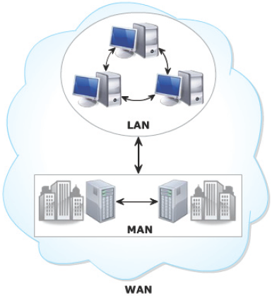
Evolution of Computing
Computing started by using stand-alone computers to perform different computing operations.
Later organizations began to connect their computers to share data.
Different types of networks are as follows:
Local Area Network (LAN)
Metropolitan Area Network (MAN)
Wide Area Network (WAN)
Notes:
Evolution : phat trien

Slide 5
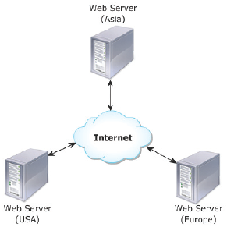
Web and Internet
Web page is a file are stored on a Web server to make them available for the users.
Web server is a computer with high processing speed and connected to the Internet.
On the internet, Information is presented in the form of Web pages
Web servers host and display the Web pages on a Web browser by using the HTTP protocol. HTTP specifies how a Web page will be retrieved from the Web server.

Slide 6
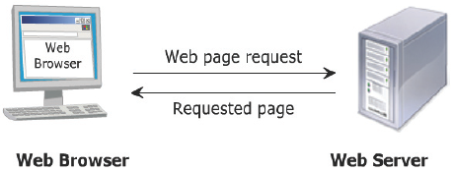
Web Communication
Steps to view a Web page in a browser are as follows:
1. User specifies the Uniform Resource Locator (URL) of Web page in browser
2. The client browser sends the URL request to the appropriate Web server
3. Web server processes the request and sends the Web page as a response to the browser.

Slide 7
Static Web Pages
Contents remain unchanged
Consists of content such as text, images, videos and so on
Static Web Pages
Focuses on content presentation
Simple to design as it provides no interactivity

Slide 8
Dynamic Web Pages
Allows customization of content and its appearance in browser
Dynamic Web Pages
Data is always up-to-date and reliable
Generates content on-demand when user provides input
Allows user interaction

Slide 9
Technologies
Technologies used for creating dynamic Web sites are as follows
JavaScript, a scripting language.
CSS specifies the formatting of a Web page for both static and dynamic Web pages.
Extensible HTML when used with JavaScript, displays the required user-defined data each time the Web page is loaded in the browser.
Dynamic HTML uses JavaScript and CSS to make dynamic Web pages and transform the look and feel of the Web pages.

Slide 10
History 1-2
HTML has evolved over the years with the introduction of improved set of standards and specifications.
HTML 3.0
HTML 3.2
HTML 4.0
HTML 5.0
Notes:
Evolve /iˈvɑːlv/ : phat trien

Slide 11
History 2-2
Basic rules for HTML5 are as follows:
Introduction to new features should be based on HTML, CSS, DOM, and JavaScript.
More markup to be used to replace scripting.
Must be device independent.
Need for external plug-in to be reduced.
Better error handling capabilities.

Slide 12
Layout of a Page in HTML 5 1-2
HTML 5 contains a head section containing the unseen elements and the body section containing the visible elements of the document.
Earlier HTML provided different tags to build and organize the content in the body of the document.
The <table> tag was an element often used to present the data in an organized manner.
The <div> tag was used to display contents such as images, links, text, menus, forms, and so on.
HTML 5 includes new elements that identify and organize each part of the document body.

Slide 13
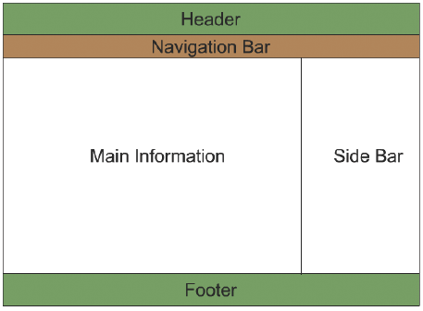
Layout of a Page in HTML 5 2-2
Has logo, name, subtitles, and short description of the Web page
Contains links for navigation
Contains product lists, description of products, blogs or any other information
Contains links that lead to certain item present internally on the Web site or an external link
Includes author or company name, links regarding rules, terms and conditions, location maps and other data

Slide 14
New and Flexible Approach of HTML5
Provides new features in CSS such as advanced selectors, drop-shadows and so on
Provides client-side storage and caching functionality
Provides new features for mobile applications
Uses the Web worker feature to make JavaScript efficient
HTML 5
Helps to create rich Internet clients using plug-ins such as Flash
Gets rid of plug-in and uses native support for audio and video
Provides descriptive semantics
Notes:
Approach : tiep can

Slide 15
Working of HTML 5
Browser loads the document which includes HTML markup and CSS style
Browser creates an internal model of the document containing HTML elements after page load
Browser loads the JavaScript code which executes after page loads
APIs give access to audio, video, and other required technologies to build the app

Slide 16
New Features of HTML5
Web workers API is added to support background process without affecting the main process
New form controls
<audio> and <video> element available for media playback
Web sockets API provides continuous connection between a server and a client
Features of HTML 5
Provides local storage support
<canvas> element used for drawing
Content specific elements helps to structure the document

Slide 17
Cascading Style Sheets (CSS)
Works along with HTML to provide visual styles to document elements.
Is a rule based language that specifies the formatting instructions for content in an HTML document.
Purpose is to separate content from its formatting.
Can define the layout and formatting of content in a separate file with a .css extension.
Allows rules from different .css files to be merged or edited.
This task of combining and matching rules from different files is referred to as cascading.

Slide 18
Benefits of CSS
Benefits of CSS
Device Independence
Code Re-usability
Less HTML code

Slide 19
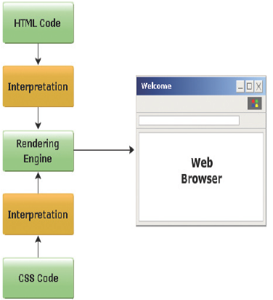
Working of CSS

Slide 20
JavaScript 1-2
Functionality of JavaScript
Allows a user to create 2D drawable surface in your page without using plug-ins.
Use Web Workers to turbo charge the JavaScript code to perform advanced computation.
Accesses any Web service and brings back the data to the application in real time.
Does not require any special plug-ins to play video.
Allows to create own playback controls using JavaScript and HTML.
Uses browser local storage and does not require browser cookies.
Can perform full video processing in the browser.

Slide 21
JavaScript 2-2
Functionality of JavaScript
Helps Web designer to insert code snippets into the HTML page without the need for in-depth programming knowledge.
Can be used to execute events on certain user actions.
Can manipulate HTML elements.
Can collect browser information of a Web site visitor.

Slide 22
jQuery
Is a JavaScript library supported on multiple browsers.
Simplifies the designing of client-side scripting on HTML pages.
Library is based on modular approach that allows creation of powerful and dynamic Web applications.
Features of jQuery
Easy to understand syntax that helps to navigate the document.
Event handling.
Advanced effects and animation.
Develop AJAX-based Web applications.

Slide 23
Summary
HTML5 is cooperative project between (W3C) and the Web Hypertext Application Technology Working Group (WHATWG).
New features of HTML5 would include tags such as <canvas>, <article>, <nav>, <header>, <footer>, <section>, <audio>, <video> and so on.
Some of the technologies used for creating dynamic Web sites JavaScript, CSS, XHTML, and DHTML.
A Cascading Style Sheet (CSS) is a rule based language, which specifies the formatting instructions for the content specified in an HTML page.
JavaScript is a scripting language that allows you to build dynamic Web pages by ensuring maximum user interactivity.
jQuery is a JavaScript library that simplifies the design of client-side scripting on HTML pages.
The major browsers, such as Chrome, Firefox, Opera, Safari, Internet Explorer, and so on, are trying to add the new HTML5 features to the latest version of the browsers.

